Slide 1
COMP1521 Week 8
(credits and thanks kyusang for the slides inspo/template)

Slide 2
Announcements
Assignment 2 should hopefully^{tm} be released soon
Assignment 1 performance marks have been released
Style marking to be completed over the next two weeks
Unexpected performance marks will be looked at by the tutors during style marking
Dont forget to do weekly tests

Slide 3
Overview
Unix Overview
“Everything is a file descriptor”
“Kinds” of files
Tutorial Q1
Useful UNIX Tools
man pages (manual)
Tutorial Questions Q2-16 (some may skip due to overlap)

Slide 4
Unix Overview

Slide 5
“Everything is a file descriptor”
One of the defining features of UNIX operating systems is the philosophy of:
“Everything is a file descriptor”
What does this mean?

Slide 6
“Everything is a file descriptor”
In the simplest terms, a file descriptor in a UNIX system can represent practically anything
This is great because you can use the same set of tools on the many things that can be represented by a file descriptor

Slide 7
“Kinds” of files
Following the previous philosophy, UNIX files can be used to represent documents, printers, keyboards, terminals, inter-process communications and even network communications (UNIX Socket)
AKA
You can represent most things on your UNIX system as a file (and treat them as such)

Slide 8
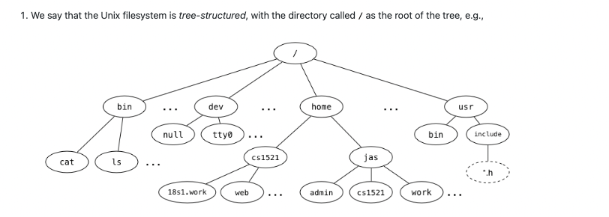
Tute Q1
What is the full pathname of COMP1521's web directory?
/home/1521/web
Which directory is ~jas/../..?
root directory, jas is short hand for home/jas
Links to the children of a given directory are stored as entries in the directory structure. Where is the link to the parent directory stored?
. = link to current directory
.. = link to the previuos directory
./ = running sth in current directory
../ running sth in the previously directory
What kind of filesystem object is cat?
Cat : a normal binary file you can run. A Regular file

Slide 9
Tute Q1
e - What kind of filesystem object is home?
Home is a directory
f- What kind of filesystem object is tty0?
tty0 is a character special file, a file that represents a device which can read and write a byte-stream, which is typically interpreted as characters.
g- What kind of filesystem object is a symbolic link? What value does it contain?
symbolic link is a file taht contains a link to anoter file
If you try to open a file, it'll open a file it is linked it
H - Symbolic links change the filesystem from a tree structure to a graph structure. How do they do this?
It creates a loop.

Slide 10
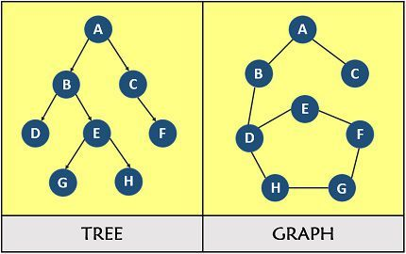
Tree vs graph

Slide 11
Q3
What does fopen do? What are its parameters?
Fopen opens a file. Takes in file name, and mode (it is in man).
-> man fopen

Slide 12
Q4
What are some circumstances when fopen returns NULL?
If fopen doesnt exist, it return NULL
Here are some of the reasons….:)
If the file you tried to open for reading does not exist.
If you try to open a file you do not have permission to access.
If the "mode" string was invalid.
If the system is out of memory.
If the pathname was too long.

Slide 13
Q9
Why should you not use fgets or fputs with binary data?
fgets or fputs work with C strings: arrays of bytes, terminated with a zero byte, '\0'.
Binary data is e.g. 0100010, doesnt have a null terminator, not a text of string
We use fgetc
When to use everything?
Fgets & fputs: string based/ “line based” -> use when you have an input of text.
Fgetc / fputc: byte based

Slide 14
11, 12
11. How many different values can fgetc return?
257
It returns one of 256 values (0…255) if it manages to read a byte, and a special value EOF if it can't.
12. Why are the names of fgetc, fputc, getc, putc, putchar, and getchar misleading?
Can use them to read bytes as well.
A lot of ppl get confused and think its just for char, but all of them read and write a byte.

Slide 15
q13
For each of the following calls to the fopen() library function, give an open() system call that has equivalent semantics relative to the state of the file.
fopen(FilePath, "r")
fopen(FilePath, "a")
fopen(FilePath, "w")
fopen(FilePath, "r+")
fopen(FilePath, "w+")
Obviously, fopen() returns a FILE*, and open() returns an integer file descriptor. Ignore this for the purposes of the question; focus on the state of the open file.
Man page time

Slide 16
q14
Consider the lseek(fd, offset, whence) function.
What is its purpose?
When would it be useful?
What does its return value represent?
E.g. do q15 if we have time

Slide 17
Useful UNIX Tools

Slide 18
man pages
manual pages
Central repository/database of information you may want to know on the current system
Table of Common Sections (Good to remember but comes with habit)
Section Number | Section Description/Purpose | Commonly Seen Pages
1 | General Commands | ls, cd, cat, ps, man, apropos
2 | System Calls (Functions provided by Kernel) | open, read, write, fork, dup2
3 | Library Calls (stdlib) | isalpha, malloc, fprintf, strcpy

Slide 19
To The Lab!

